Slide 1
Programming in the Cloud
Lecturer: Ngo Huy Bien
Software Engineering Department
Faculty of Information Technology
VNUHCM - University of Science
Ho Chi Minh City, Vietnam
nhbien@fit.hcmus.edu.vn

Slide 2

Objectives

Slide 3

Contents
MapReduce

Slide 4

References
Gautam Shroff (2010). Enterprise Cloud Computing: Technology Architecture Applications. Cambridge University Press.

Slide 5

Parallel Computing [1]
The premise of parallel computing is that a task that takes time T should take time T/p if executed on p processors.
The parallel efficiency of an algorithm is defined as:
Tp: the time to execute on p processors
A scalable parallel implementation is one where:
the parallel efficiency remains constant as the size of data is increased along with a corresponding increase in processors and
the parallel efficiency increases with the size of data for a fixed number of processors.

Slide 6
Parallel Efficiency Example
If there are n documents and m distinct words, we wish to determine m frequencies, one for each word.
Two approaches to compute these frequencies in parallel using p processors:
(a) let each processor compute the frequencies for m/p words
(b) let each processor compute the frequencies of m words across n/p documents, followed by all the processors summing their results
Assume that the time spent c for reading each word in the document is the same as that of sending it to another processor via inter-processor communication. Assume that each word occurs f times in a document, on average.
The time for computing all the m frequencies with a single processor is n×m×f×c.

Slide 7

Parallel Efficiency Example (a)
Using approach (a) each processor reads approximately n×m×f words and adds them n×(m/p)×f times. Ignoring the time spent in additions, the parallel efficiency can be calculated as:

Slide 8
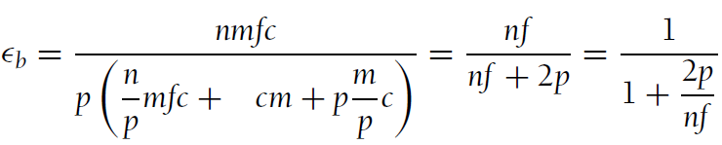
Parallel Efficiency Example (b)
Using approach (b) each processor performs approximately (n/p)×m×f reads and the same number of additions in the first phase, producing p vectors of m partial frequencies, which can be written to disk in parallel by each processor in time cm.
In the second phase these vectors of partial frequencies need to be added: First each processor sends p − 1 sub-vectors of size m/p to each of the remaining processors. Each processor then adds p sub-vectors locally to compute one pth of the final m-vector of frequencies.
The parallel efficiency is computed as:

Slide 9
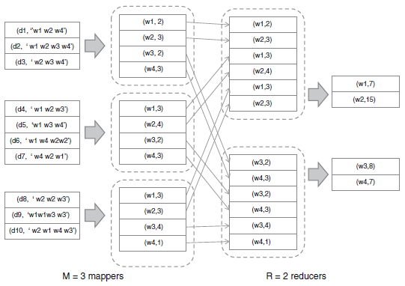
MapReduce Model
MapReduce proceeds in two phases, a distributed "map" operation followed by a distributed "reduce" operation;
at each phase a configurable number of M "mapper" processors and R "reducer" processors are assigned to work on the problem.

Slide 10


Slide 11
MapReduce
context: multi-hour computations on multi-terabyte data-sets
e.g. build search index, or sort, or analyze structure of web
only practical with 1000s of computers
applications not written by distributed systems experts
overall goal: easy for non-specialist programmers
programmer just defines Map and Reduce functions
often fairly simple sequential code
MR takes care of, and hides, all aspects of distribution!

Slide 12
MapReduce Example
input is (already) split into M files
Example: Count the number of word: a, b, c in files.
Input1 -> Map -> a,1, a,1, b,1, b,1
Input2 -> Map -> b,1
Input3 -> Map -> a,1 c,1
| | |-> Reduce -> c,1
| |------------> Reduce -> b,3
|-----------------------> Reduce -> a,3

Slide 13
Abstract View of a MapReduce Job
MR calls Map() for each input file, produces set of k2,v2 "intermediate" data
each Map() call is a "task"
MR gathers all intermediate v2's for a given k2,
and passes each key + values to a Reduce call
final output is set of <k2,v3> pairs from Reduce()s

Slide 14
Example: word count
input is thousands of text files
Map(k, v) (v = text)
split v into words
for each word w
emit(w, "1") ("abba"-> ("a", "1"), ("b", "1")
("b", "1"), ("a", "1"))
("b" -> ("b", "1"))
("ac" -> ("a", "1"), ("c", "1"))
Reduce(k, v) (v = list)
emit(len(v)) ("a", {"1", "1", "1}) -> ("a", 3)
("b", {"1", "1", "1"}) -> ("b", 3)
("c", {"1"}) -> ("c", 1)

Slide 15
MapReduce Scales Well
N "worker" computers get you Nx throughput.
Maps()s can run in parallel, since they don't interact.
Same for Reduce()s.
So you can get more throughput by buying more computers.

Slide 16
MapReduce Hides Many Details
sending app code to servers
tracking which tasks are done
moving data from Maps to Reduces
balancing load over servers
recovering from failures

Slide 17
MapReduce Limits What Apps Can Do
No interaction or state (other than via intermediate output).
No iteration, no multi-stage pipelines.
No real-time or streaming processing.

Slide 18
Input and Output are Stored on the GFS Cluster File System
MR needs huge parallel input and output throughput.
GFS splits files over many servers, in 64 MB chunks.
Maps read in parallel.
Reduces write in parallel.
GFS also replicates each file on 2 or 3 servers.
Having GFS is a big win for MapReduce.

Slide 19

Thank You & See You Again

